Slide 1


AI-based Active and Social Learning
Nicholas Koh U1622054A

Slide 2

Table Of Content
Active Learning
Introduction of Clustering
Objectives
Definition
Introduction of Analytics and filtering
Comparison of Clustering Methods
Introduction
Technologies used
Proposed LMS
Demo

Slide 3
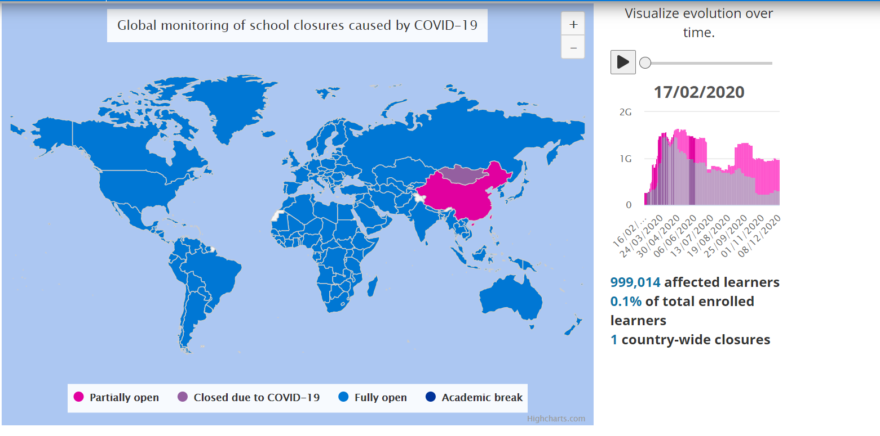
Introduction
Image taken from Unesco,2020

Slide 4
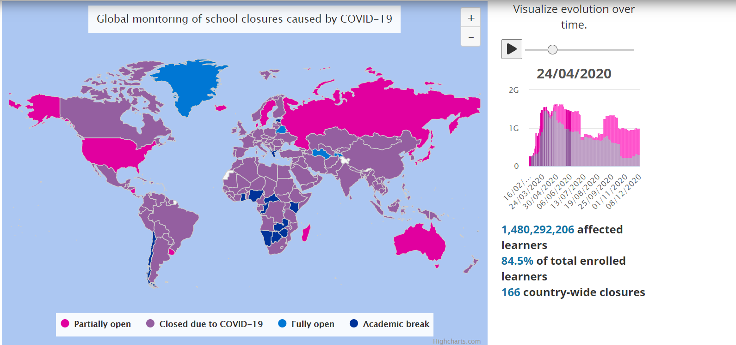
Introduction
Image taken from (Unesco,2020)

Slide 5

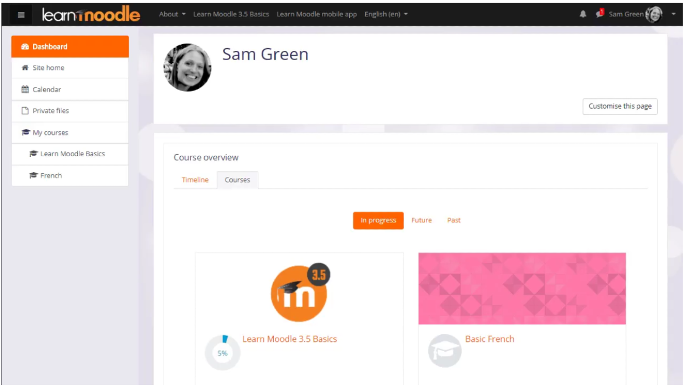
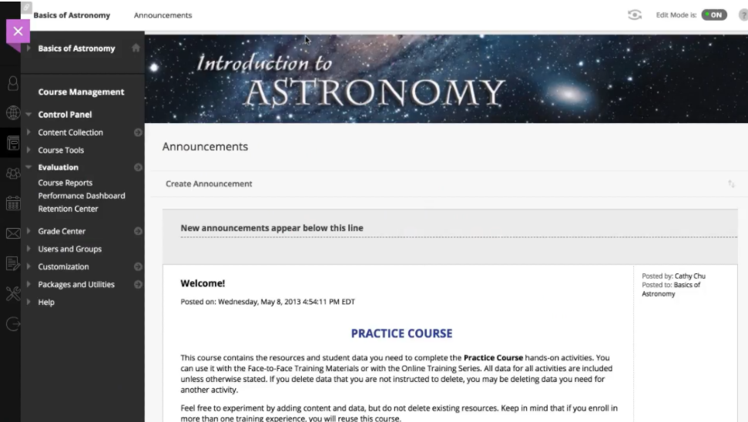
Introduction (Comparison of Different LMS)
Image taken from Moodle
Image taken from BlackBoard

Slide 6
Objective
To discuss in depth what active learning is
To mention some of the activities that facilitate active learning
To implement an effective LMS platform
To discuss the analytics offered on the new LMS platform
To eventually run a clustering algorithm within the LMS platform

Slide 7
Definition- Active Learning
Learners are engaged in the learning process
Learners participate more in discussion, problem solving to apply the knowledge taught
Responsibility falls on the learners to take an active role in reinforcing their own learning
Active learning promotes deep thinking and the application of knowledge (what is active learning, 2020)

Slide 8
Active Learning
Builds understanding behind concepts
Focuses more on knowledge construction rather than transmission
Adopts a more hands-on approach in learning

Slide 9

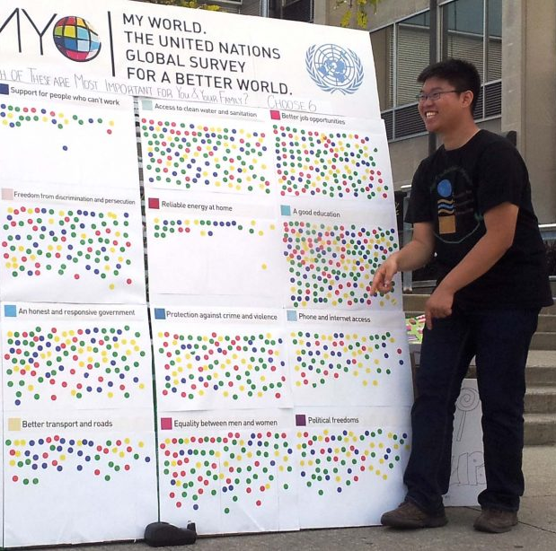
Active Learning Activities
Learning by teaching
Small group discussions
Debates
Think-Pair Share
Sticky note Clustering
Dotmocracy (Active learning activities,2019)
Image taken from www.dotmacracy.org

Slide 10
Social media in active learning
Pinterest
It is a form of sticky clustering as it allows users to “pin up” images to form mood boards
Can be a good way for students to source for inspiration and pin it up for future reference
Can be implemented as a tool to administer sticky clustering among students in class
YouTube
Video sharing platform which students can use to upload educational videos
Students can use this platform to look up videos on a wide range of topics
Useful for reinforcing knowledge taught in class or for exploring new topics of interest
Facebook
Comment functions allow people to actively discuss on certain articles or debate over an article
Information sharing is easier with the use of Facebook
This promotes interaction and discussion among users
Live chats can be a tool used to host live debates over a topic to engage audience. (University of Arizona Global Campus, Apr 2020)

Slide 11
Technologies used
This section discusses some of the technologies used for the project. As the time frame of the project is relative lesser, things that are easier to pick up or learn are chosen.

Slide 12


Front End
Declarative, efficient and flexible
The use of virtual Document Object Models makes development faster
Reusable components
No need to worry much about data flow
Built-in components allow the implementation of google analytics which will be used in the platform

Slide 13

Front End
Interpreted, object oriented high level language
Useful for rapid application development
Ease of reading, writing and learning
Portable
Dynamically typed reduces the need to worry about data structures frequently

Slide 14

Back End
Robust technology stack
Scalability
Seamless JSON Support

Slide 15

Back End
Secure
Scalability
High Performance

Slide 16
Use of analytics in LMS
This section discusses some of the different analytics that can be used to give more insight into the LMS as users start using the platform. I will be mainly talking about Web Log analytics, Life Cycle Analysis and Learning Progression Analysis

Slide 17
Web Log Analytics
Employs the use of user history and behaviour to gain insight into their usage pattern
Analysis of logs allows admin to determine level of community fostered within the platform (Taylor, J. E., & Ku, H.-Y. ,2011)
Based on user usage patterns
Indicators include
Visit times
Duration of visits
Number of visits
Most/ least viewed pages
Number of comments made (University of Waterloo, 2019)

Slide 18
Life –Cycle analysis
Focuses on individual students and their involved study groups
Difficult to pass down information in higher level of education
Life cycle analysis determines if the right amount of resources are spent, are the materials relevant or kept up to date regularly
Life cycle analysis at every step of development of the LMS allows developer to regularly update the platform to fit student’s varying levels, the organization's expectations and the relevancy of the content provided
Scope includes
Resources spent
Technology adoption levels
Learning participation (Hasegawa, Shinobu & Ochimizu, K.., 2005)

Slide 19
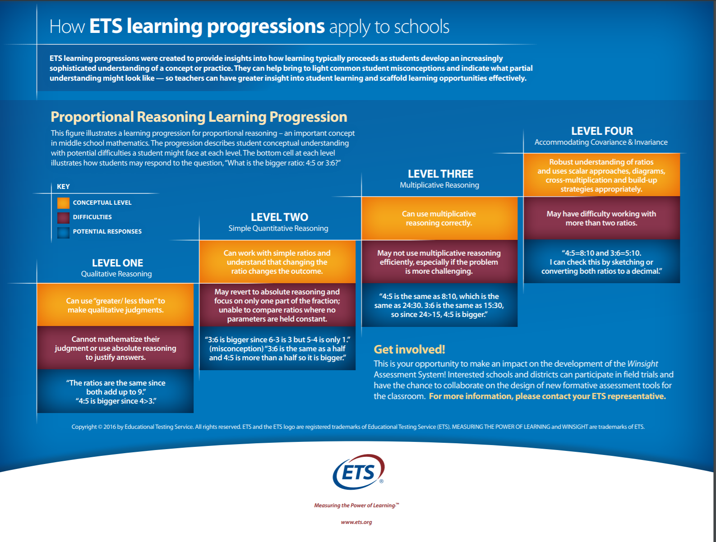
Learning Progression Analysis
Focuses on the analysis of the growth of students with respect to their learning
More important especially in STEM education
The use of a learning progression scorecard to identify/ differentiate between students in terms of their mastery of their knowledge.
Image taken from https://www.ets.org/s/winsight/pdf/learning-progressions-sell-sheet.pdf

Slide 20
Introduction of Clustering and Content filtering
Content-based filtering
Determines whether the right content reaches the right people
Recommends content based on certain factors
User preference
User history
Explicit feedback from user

Slide 21
Introduction of Clustering and Content filtering
Collaborative filtering
Determines whether the right content reaches the right people
Recommends content based on similarities between users and content simultaneously
It takes in feedback directly from the user (for example, a movie rating provided by the user) and an implicit feedback that a user might like a certain movie (based on how similar this movie is compared to movies the user has already watched)

Slide 22
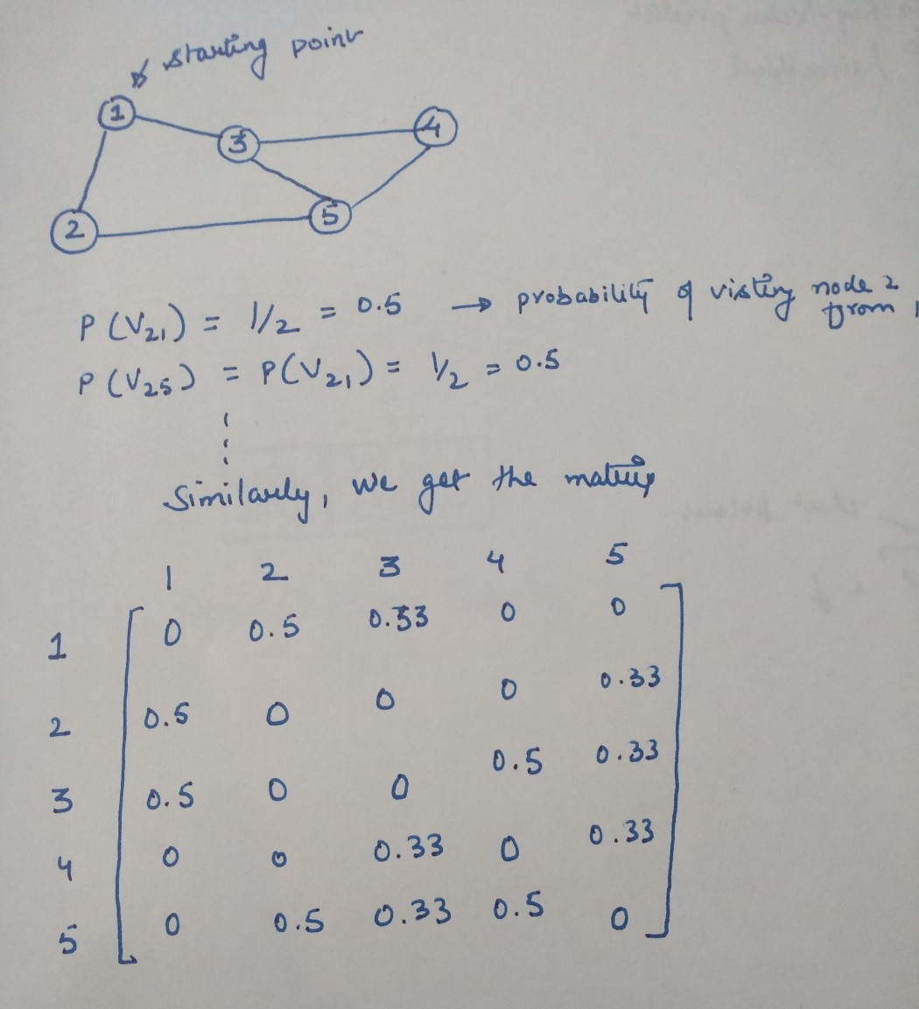
Markov Clustering Algorithm
Based on performing random walks on graphs
Deals with a probability matrix to determine the probability of the chances a node will reach a next one independent of their previous states.
Markov Chains
“a system in which the next state is dependent upon the current state based on some probability or rule.”

Slide 23
Markov Clustering Algorithm
To implement the clustering algorithm, there are 2 operations involved,
Inflation
Transition values in the matrix are changed so strong neighbours are strengthened and large neighbour values are demoted. This is done by raising the column value to non-negative power and then renormalizing
Therefore, for inflation value of 2. Square each element in the column and normalize the values
Responsible for strengthening and weakening of current.
Expansion
Helps make further nodes reachable by taking the nth power of the matrix
For expansion power of 2 and matrix A, take the power of the matrix\
Responsible to allow flow to connect to different regions of the graph

Slide 24
Markov Clustering Algorithm
Input is a un-directed graph, power parameter e and inflation parameter r.
Determine the Markov matrix by creating the associated matrix (based on the probability of each of the states happening)
Random walk is simulated by alternating between Inflation and Expansion
Step i: Expand that matrix using ‘e’ parameter’
Step j: Inflate that matrix using “r” parameter
Repeat steps I and j until convergence (or when there is no significant change in values observed)
Interpret the relevant matrix to obtain the clusters (Valsamidis, , Kontogiannis, S., Kazanidis, Ioannis. T ,& Karakos. A. (2012). )

Slide 25
Markov Clustering Algorithm
MCL scales well with larger graph size
Produces good clustering results
Usually doesn’t produce overlapping clusters
Not useful in explaining events ( does not provide insight)

Slide 26
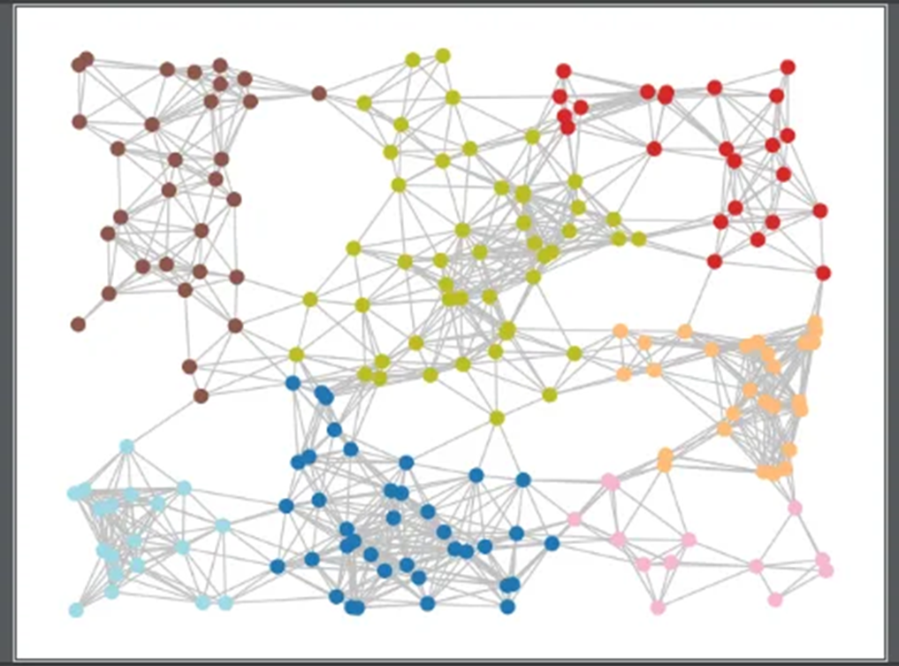
Markov Clustering Algorithm
Random datapoints were generated by python for the sake of performing clustering
Algorithm identified 7 different clusters (shown above)
Clusters do not have many bridging nodes
Probability of different groups interacting ls lower

Slide 27
K-Means Clustering
Designed to cluster N objects in a data set into k different partitions
K is usually defined by the user in the code
An objected is clustered based on its vector distance to the centroid vector ( usually defined) within a cluster
Centroid of a Cluster C_{k} is determined by finding the average of each variable divided by the number of objects within the cluster. (Steinley, D., & Brusco, M. J. (2007))

Slide 28
K-Means Clustering
K which determines the number of clusters is defined.
K- number of random data points are selected as the center of a cluster.
Data points are initially assigned to a cluster based on their Euclidean distance to a center of a cluster (centroid)
Mean value of the data points in the same cluster is calculated and this will be assigned as a new centroid
Data will be reassigned to a cluster based on its Euclidean distance to the new centroid
Step 4 and 5 is repeated until a stopping condition is met
*stopping condition can either be:
Running through the set number of iterations
Centroid value for next iteration does not change

Slide 29
K-Means Clustering
Easy to implement
Scales with large data set
Guarantees convergence
Have to determine the correct “k” value
Dependent on “k” values
Not useful in clustering data of varying size and density
Outliers

Slide 30
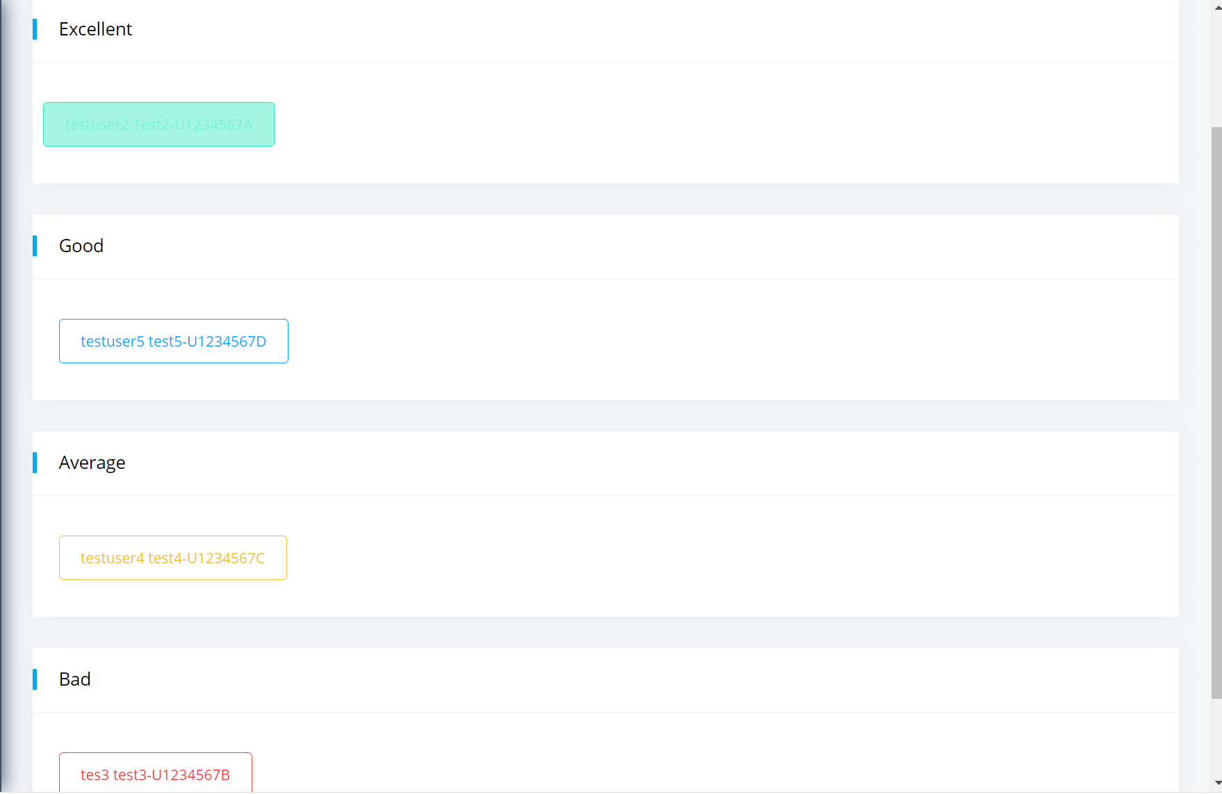
K-Means Clustering
K was set to 4 for simplicity’s sake
Data was fed into python to utilize python’s library “sklearn” which was used to perform the clustering
Results are based on user browsing history on the platform

Slide 31
Demo

Slide 32
Q&A
Thank You

Slide 33
References
UNESCO. (2020, September 08). Education: From disruption to recovery. https://en.unesco.org/covid19/educationresponse
What is Active Learning. https://www.queensu.ca/teachingandlearning/modules/active/04_what_is_active_learning.html. Accessed 10 Dec 2020.
Active Learning Activities. (March 04, 2019). Centre for Teaching Excellence.
https://uwaterloo.ca/centre-for-teaching-excellence/teaching-resources/teaching-tips/developing-assignments/assignment-design/active-learning-activities
Using Social Media for Learning. (2020, Apr 03). The University of Arizona Global Campus. https://www.ashford.edu/blog/online-learning/using-social-media-as-a-learning-tool
Taylor, J. E., & Ku, H.-Y. (2011). Measuring active learning to predict course quality. Performance Improvement Quarterly, 24(1), 31–48. doi:10.1002/piq.20104
Hasegawa, Shinobu & Ochimizu, K.. (2005). A learning management system based on the life cycle management model of e-learning courseware. 35 - 37. 10.1109/ICALT.2005.11.)
Valsamidis, Stavros & Kontogiannis, S. & Kazanidis, Ioannis & Theodosiou, Theodosios & Karakos, Alexandros. (2012). A Clustering Methodology of Web Log Data for Learning Management Systems. Educational Technology and Society. 15
Steinley, D., & Brusco, M. J. (2007). Initializing K-means Batch Clustering: A Critical Evaluation of Several Techniques. Journal of Classification, 24(1), 99–121. doi:10.1007/s00357-007-0003-0

